Slide 1
Emotional Robot

Slide 3
Emotion Recognition versus Emotion Generation

Slide 4
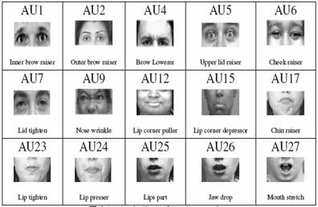
Recognizing Emotions
in Human Face

Slide 5
PCA + NN software of Labunsky

Slide 8
Generating Emotional Motions

Slide 9
Spectral filtering
Matched filters
Hermite interpolation
Spline Interpolation
Wavelets
Repetitions
Mirrors

Slide 11
Editor of wwaveforms

Slide 12
Ideas for Future Robot Theatres and “Installations”

Slide 13
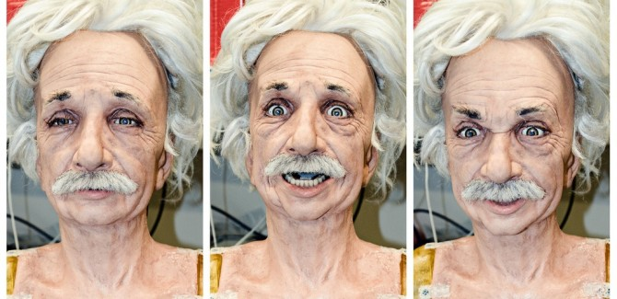
Realistic actors

Slide 14
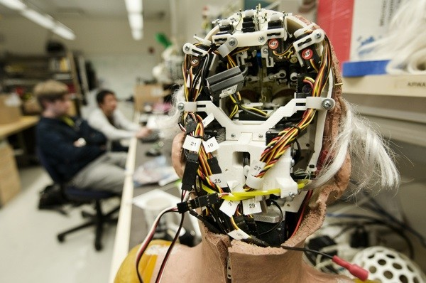
A need for a better actuator

Slide 15
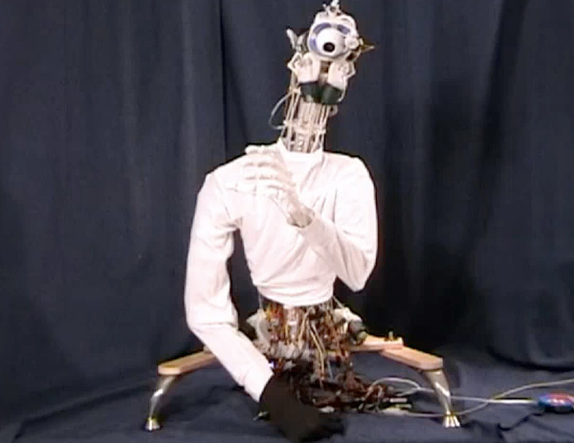
Anthropomimetic robots.
he ECCEROBOT is just such a robot, and it's really a sight to behold. Developed by a consortium of European robotics labs, the motivation behind the creation is to more accurately copy human internal structure, using thermoplastic polymer for bones, screwdriver motors and shock cord for muscle, and kiteline for tendons.
The results are impressive, if not a bit creepy. According to IEEE Spectrum, scientists hope in the future to use ECCEROBOT's human-like form to "explore human-like cognitive features," which may or may not include starring opposite Christian Bale in science fiction films.

Slide 16
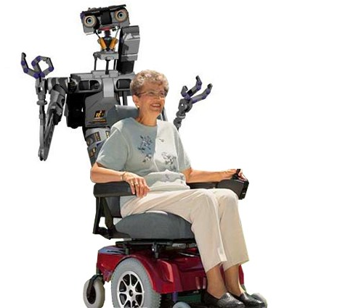
Robot actor as a caregiver and permanent entertainer

Slide 17
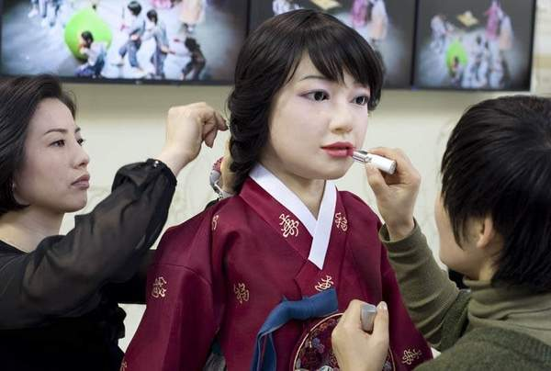
Fashion and Hospitability Industry
Women make up a humanoid robot called EveR-3 of the Korea Academy of Industrial Technology (Kaitech), for a show at the Hanover industrial fair in Hanover, Germany, Sunday, April 19, 2009

Slide 18
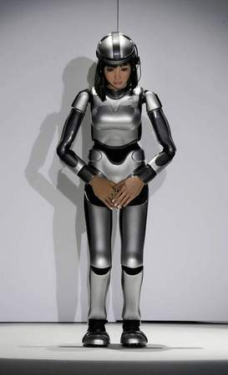
A place for a female robots - fembots
A "cybernetic human" robot code-named HRP-4C bows and greets people on the catwalk during a fashion show as part of the opening day event of Japan Fashion Week in Tokyo, Japan.
The 158 centimeter (62.2 inch) tall black-haired robot, developed at the National Institute of Advanced Industrial Science and Technology, a government-backed organization, has trimmed down to 43 kilograms (95 pounds) to make the debut at a fashion show.

Slide 19
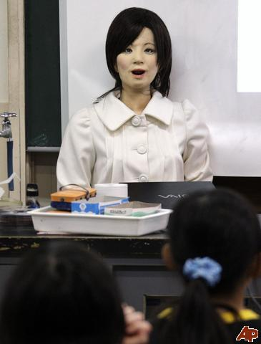
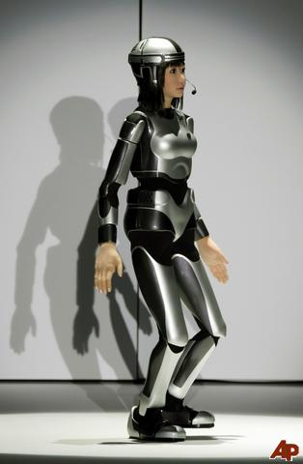
Japanese Realistic Androids
Robot to advertise alcohol in Sweden

Slide 20
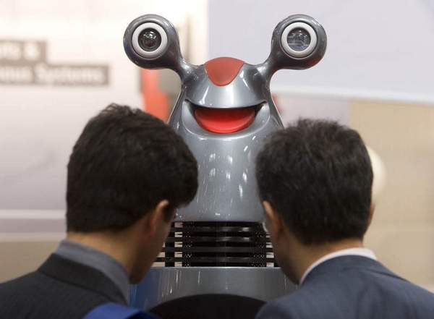
Robots as providers of information
The entertainment robot Gilberto at the industrial fair in Hanover, Germany, Tuesday, April 21, 2009. Gilberto is intended to work as a guide and information desk in airports, train stations, museums.

Slide 21
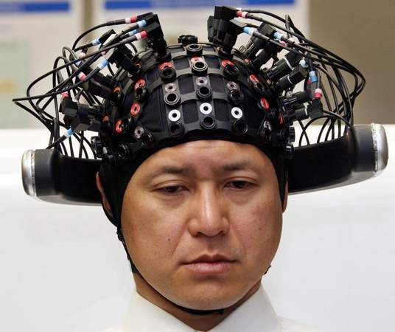
Robot Theatre controlled directly from brains of humans: directors, actors, audience?
A Honda Motor Co. employee puts on a headgear with codes attached during a demonstration of Honda's new technology linking brain thoughts with robotics at the Japanese automaker's headquarters in Tokyo, Japan. Honda has developed a way to read patterns of electric currents on a person's scalp as well as changes in cerebral blood flow when a person thinks about four simple movements -- moving the right hand, moving the left hand, trotting and eating.

Slide 22
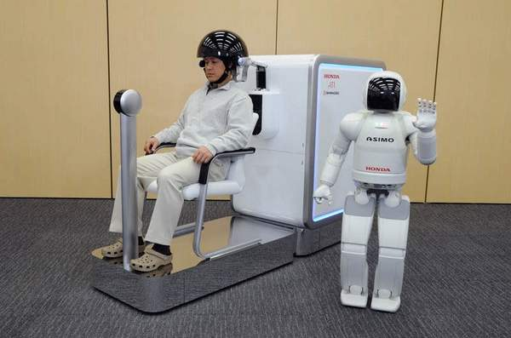
Honda brain activity measuring device controlling ASIMO robot by human thought alone. (AP)

Slide 23
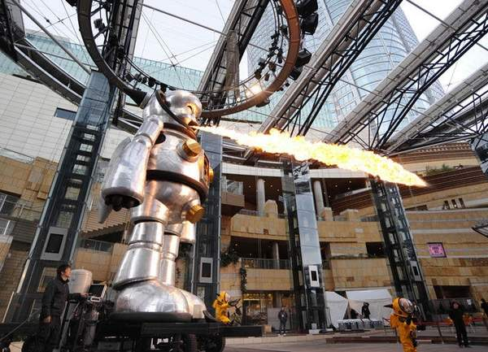
Giant robots
A 7.2-meter (23.6 foot) tall aluminum made robot "Giant Torayan" blows fire into the air during a rehearsal of the "Roppongi Art Night" special art event at Roppongi Hills in Tokyo, Japan. The robot, created by Japanese artist Kenji Yanobe, is one of main art installations for the event that aims to transform the entire area of Roppongi under the theme of "Encounters."

Slide 24
New forms of life

Slide 25
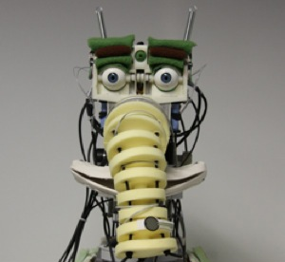

Slide 26
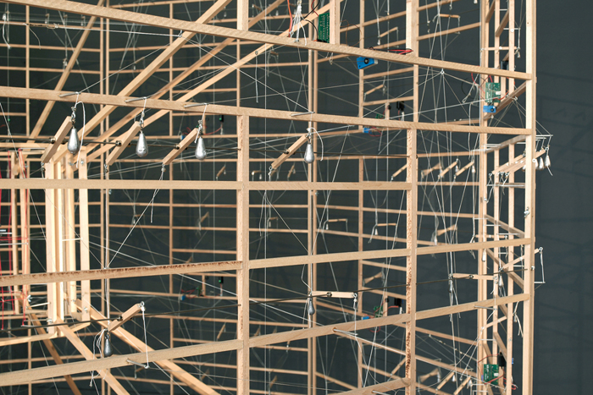
Robot sculptures

Slide 27
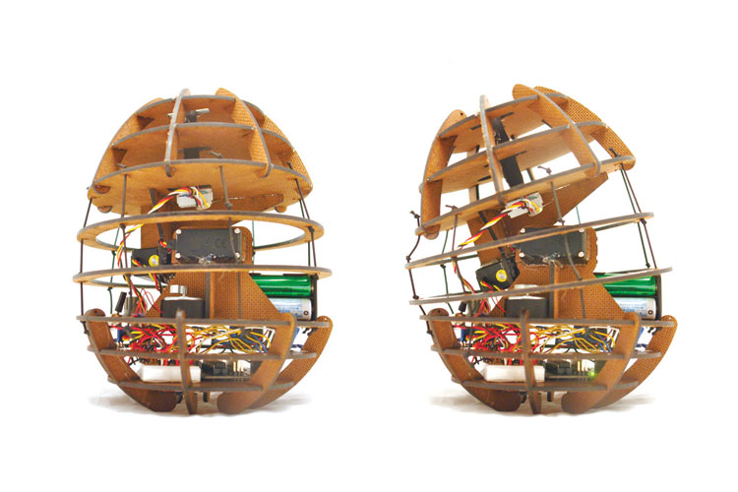
New forms of realism

Slide 28
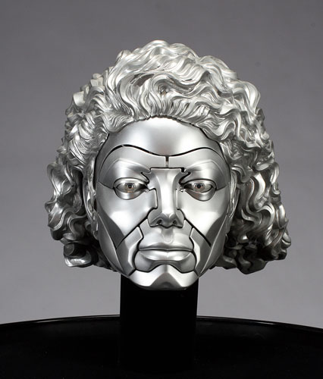
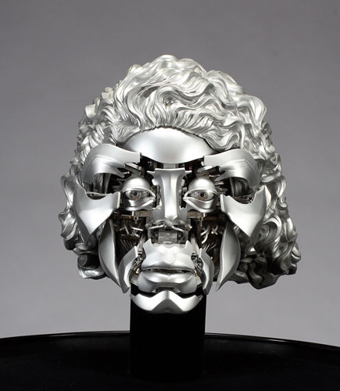
Michael Jackson Robot Head 2009

Slide 29
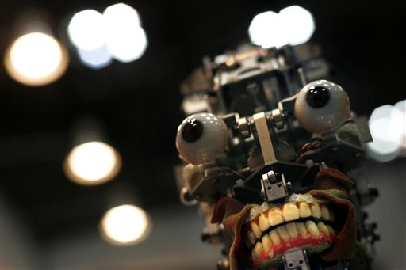
Interactive begging robots – sculpture in time - personality

Slide 30
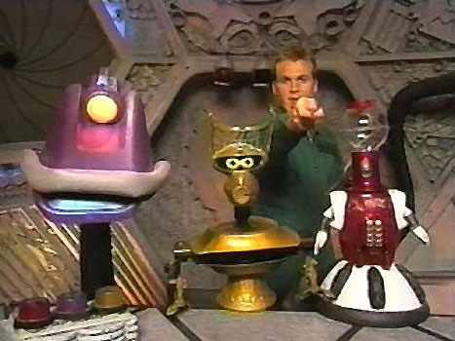

Slide 31
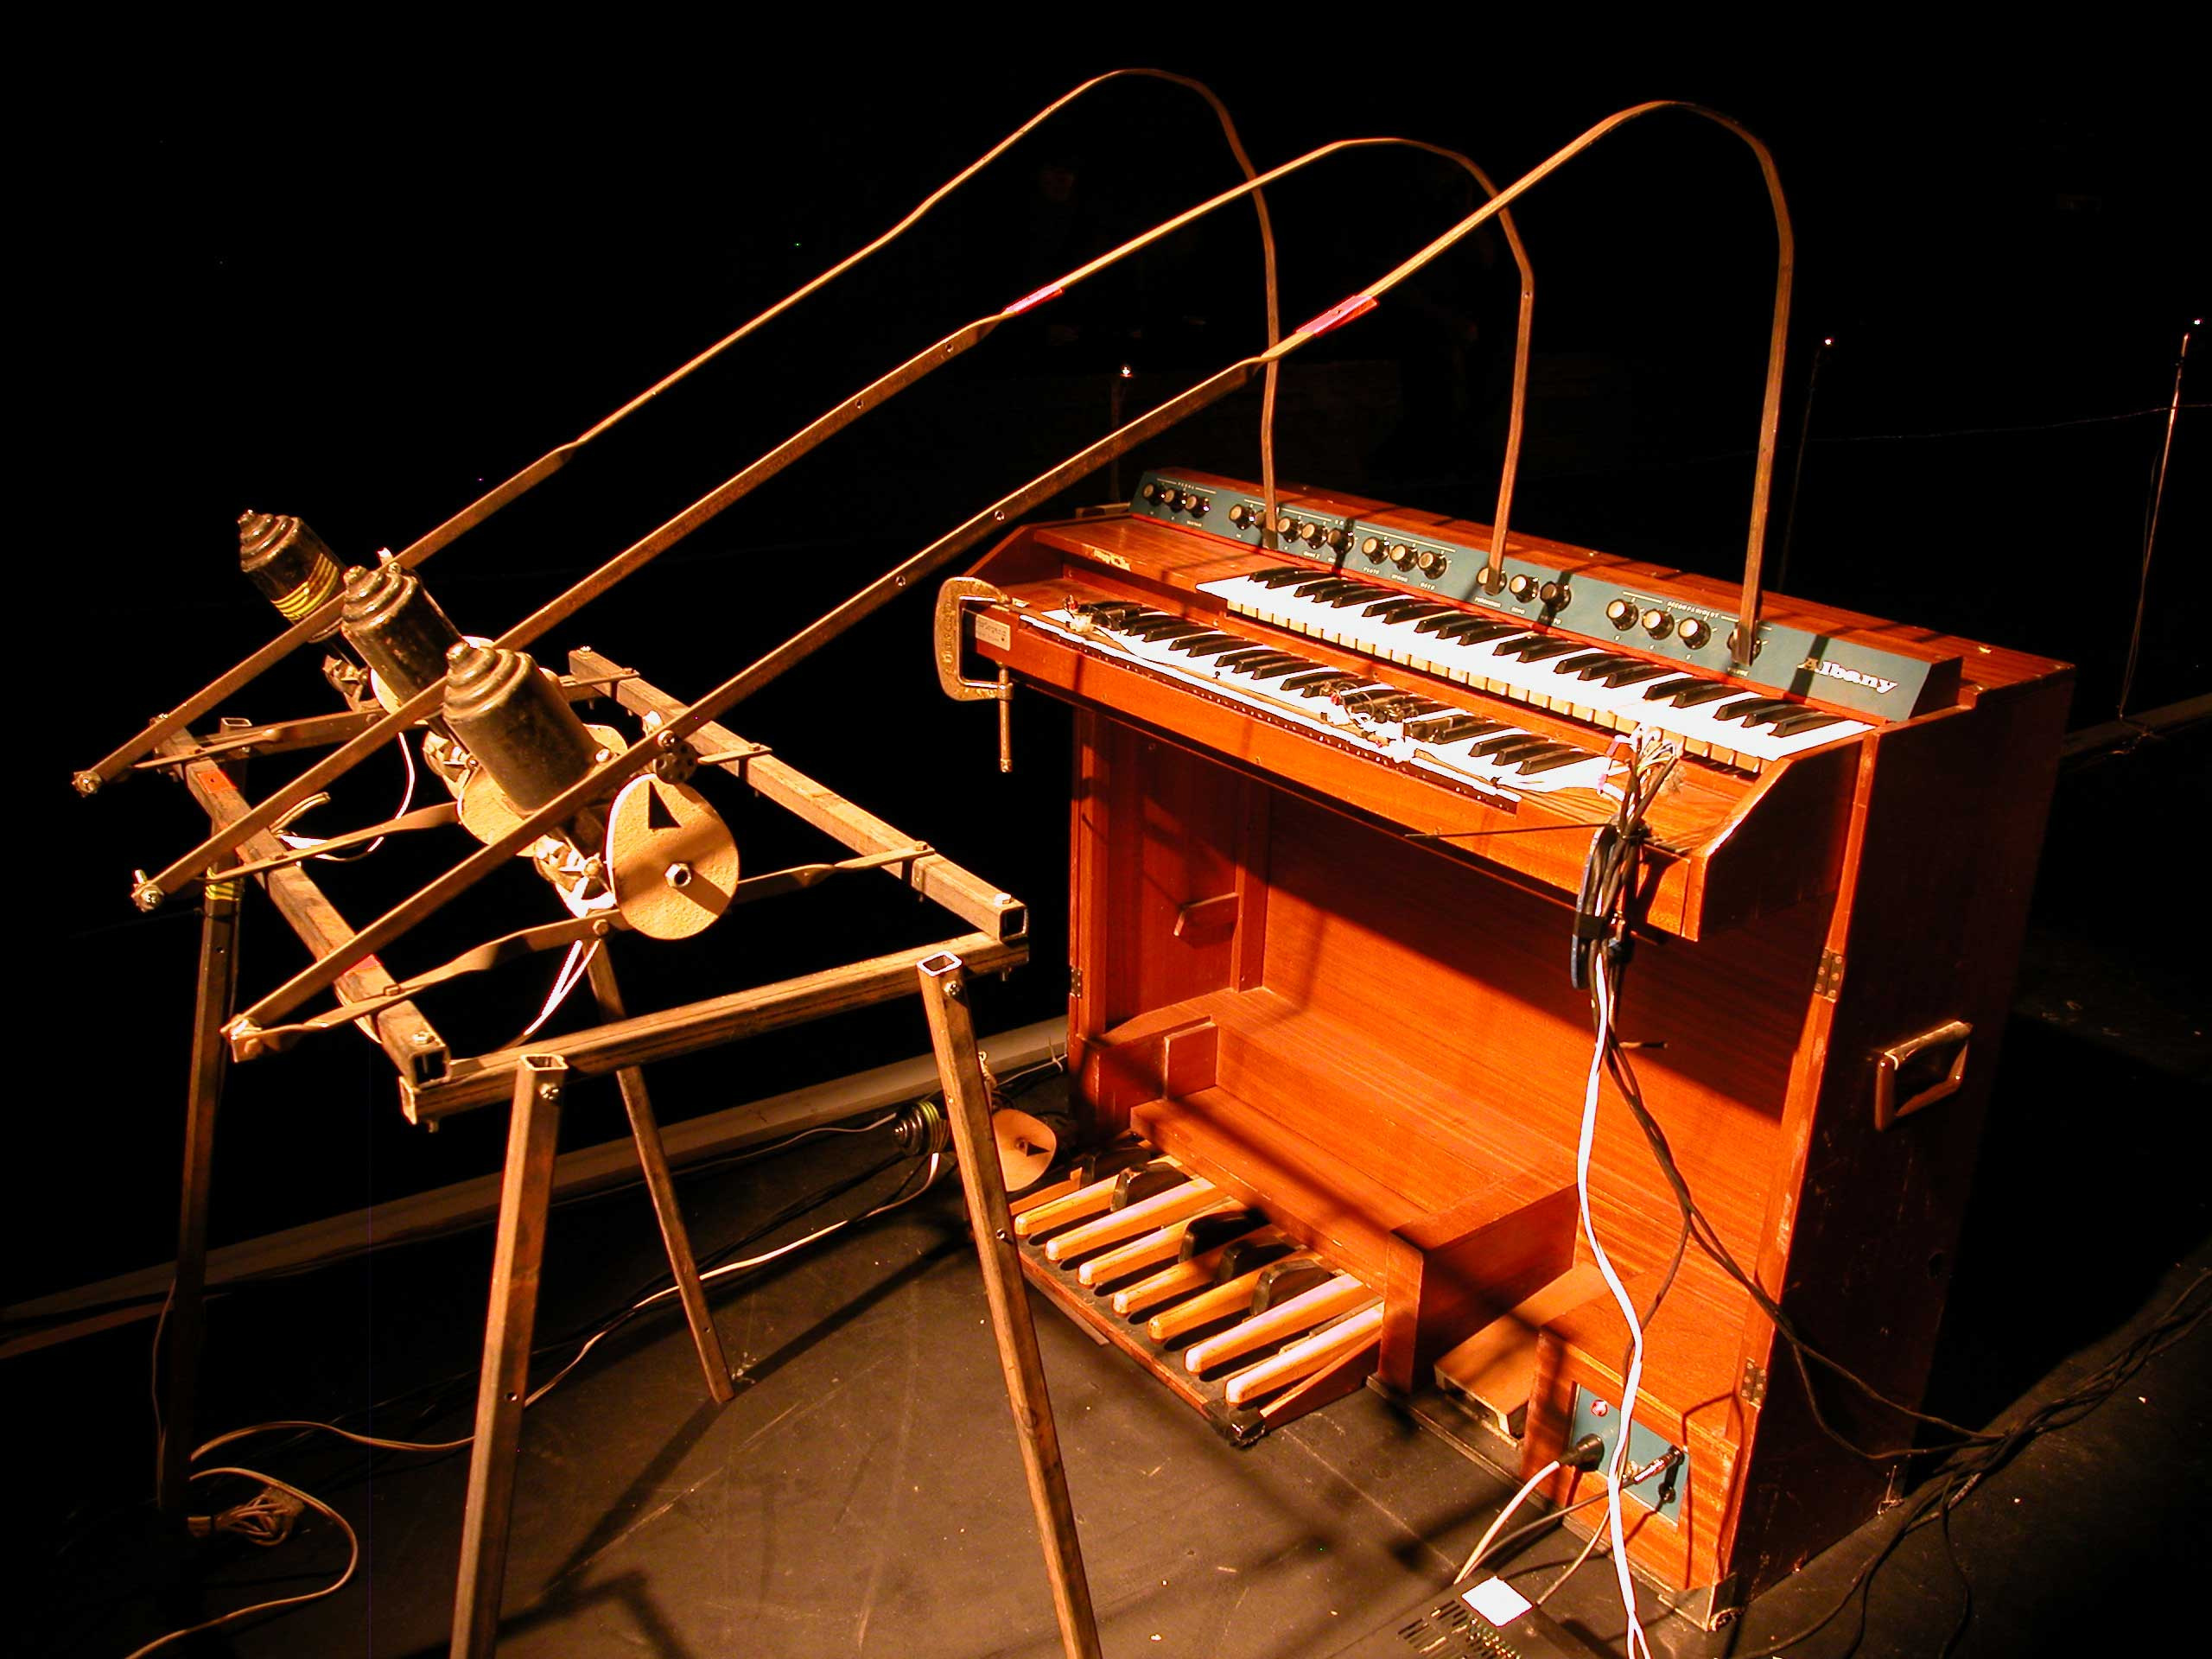
Robotic music instruments and Orchestras

Slide 32
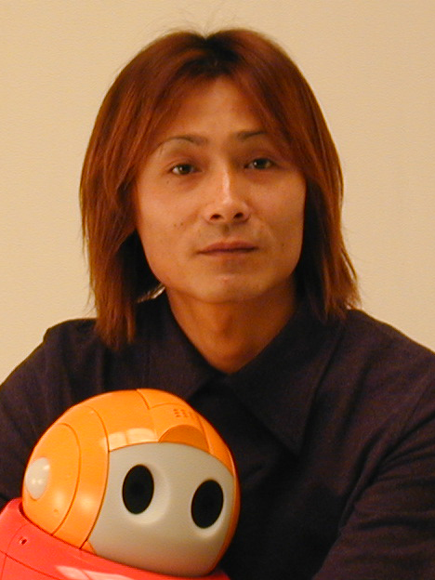
New theatre forms, ritual, spiritual, resurrecting old theatre such as Noh or Bunraku
ISMAR Workshop on Mixed Reality Entertainment and Art Keynote
Lecture and demo by World Famous Robot Designer, Japanese television comedian, and NEC PAPERO robot for the first time in Noh Theatre:
Topic: Noh Theatre Version: Research Collaboration for “Humorous Interaction” 2-Man Stand-Up Comedy (Manzai) with a Robot

Slide 33
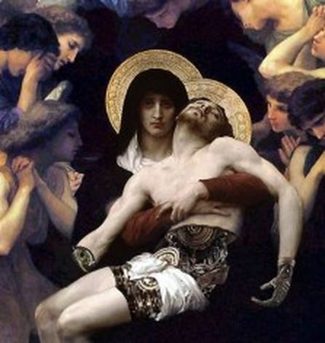
Shocking concepts in philosophy, art and theatre

